Slide 1

EE 243: Advanced Computer Vision
Presentation on
3D Gaussian Splatting for Real-Time Radiance Field Rendering
HUGS: Human Gaussian Splats
Group May/29/2024 - Akhil Joshi , Ming lee and
Rathin Raj Rajamanickam Sudhakaran

Slide 2
Overview of 3D Gaussian Splatting for Real-Time Radiance Field Rendering
Problem Statement - High visual quality in novel-view synthesis often requires costly and time-consuming neural network training.
Current Solution - The authors aim to develop a method that can achieve state-of-the-art visual quality while maintaining competitive training times and enabling high-quality real-time (≥ 30 fps) novel-view synthesis at 1080p resolution.
How They Solve It -
3D Gaussians Representation: They represent the scene with 3D Gaussians that maintain the desirable properties of continuous volumetric radiance fields but avoid unnecessary computation in empty space.
Optimization/Density Control: They perform interleaved optimization and density control of the 3D Gaussians, optimizing anisotropic covariance to accurately represent the scene.
Visibility-Aware Rendering Algorithm: They develop a fast rendering algorithm that supports anisotropic splatting, which accelerates both training and rendering processes.

Slide 3
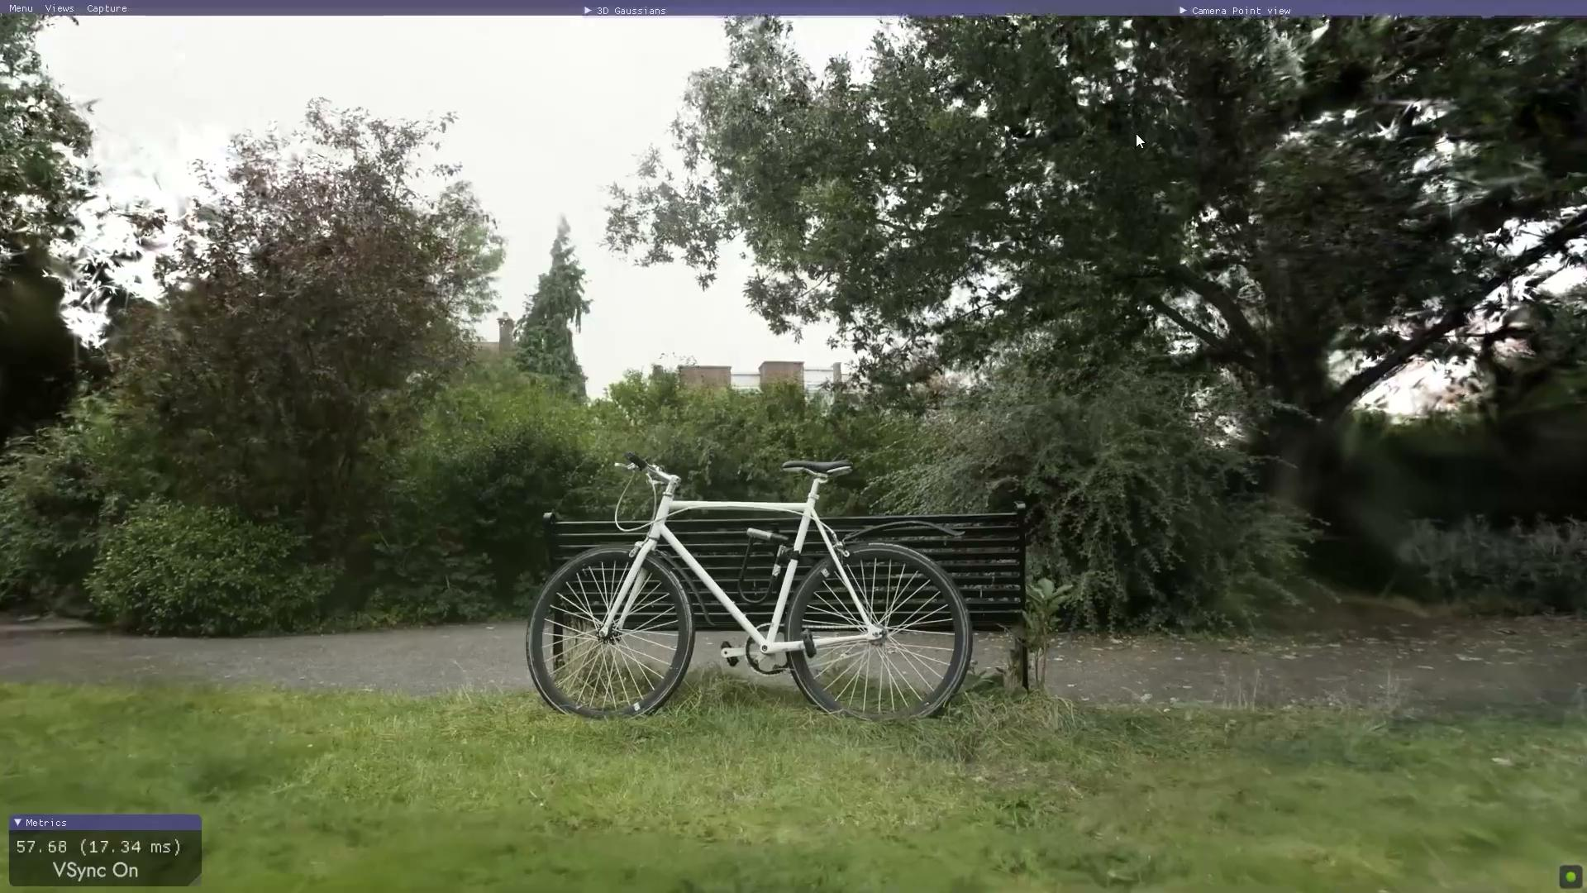
Final Result

Slide 4
Overview of Human Gaussian Splats (HUGS)
Problem Statement - This paper addresses the challenge of creating animatable human avatars from monocular video data, particularly the difficulty of capturing detailed and realistic human animations and scenes efficiently.
Current Solution - The authors aim to develop a framework that can quickly and efficiently create high-quality animatable human avatars and scenes from a small number of video frames, enabling fast training and rendering.
How They Solve It -
3D Gaussian Splatting for Humans: They use 3D Gaussian splatting to represent both the human and the scene, which allows for efficient training and high-quality rendering.
Disentangling Human and Scene: The method disentangles the static scene from the fully animatable human avatar using 3D Gaussians.
Linear Blend Skinning (LBS) Weights: They introduce a novel deformation model using LBS weights to coordinate the movements of individual Gaussians during animation, capturing fine details such as hair and clothing.

Slide 5
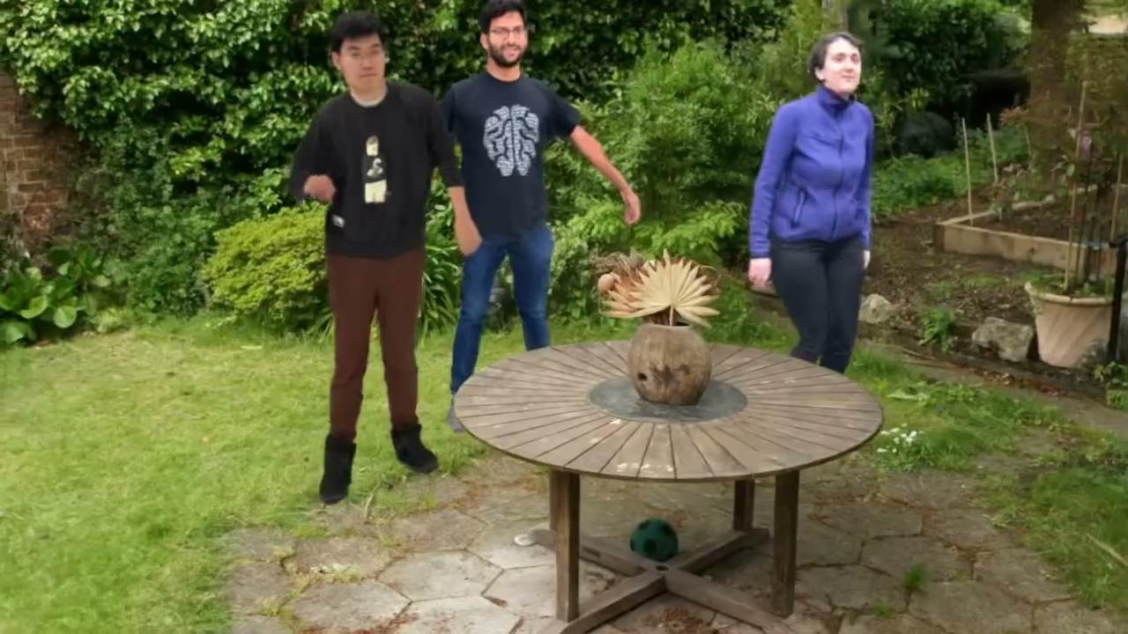
Final Result

Slide 6
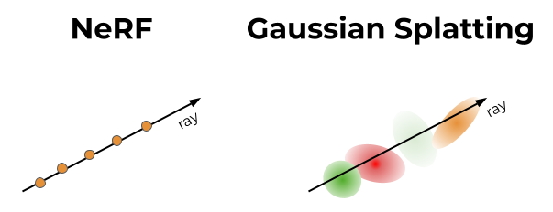
Background NeRF VS 3D Gaussian Splatting
Representation: 3D Gaussian Splatting uses a collection of 3D Gaussian functions to represent the scene
Rendering: 3D Gaussian Splatting performed by projecting these Gaussians onto the image plane and accumulating their contributions to form the final image.
Training/Optimization: This method can either optimize the parameters of the Gaussians or use a pre-trained model to determine the parameters.
Methodology
Representation: NeRF represents a scene as a continuous volumetric field.
Rendering: NeRF involves sampling points along rays and using the neural network to predict then accumulated to form the final image.
Training: NeRF requires training on a set of images with known camera positions.
Notes:
Representation: NeRF represents a scene as a continuous volumetric field. It uses a neural network to model the color and density at any point in space.
Rendering: NeRF employs volumetric rendering techniques to produce images by integrating along rays cast through the scene. This involves sampling points along rays and using the neural network to predict color and density, which are then accumulated to form the final image.
Training: NeRF requires training on a set of images with known camera positions. The neural network learns to approximate the radiance field by minimizing the difference between the rendered views and the input images.
Representation: 3D Gaussian Splatting uses a collection of 3D Gaussian functions to represent the scene. Each Gaussian defines a point in space with a position, size, and color distribution.
Rendering: Rendering is performed by projecting these Gaussians onto the image plane. The splatting process involves rasterizing these Gaussians and accumulating their contributions to form the final image.
Training/Optimization: This method can either optimize the parameters of the Gaussians directly from the input images or use a pre-trained model to determine the parameters.

Slide 7
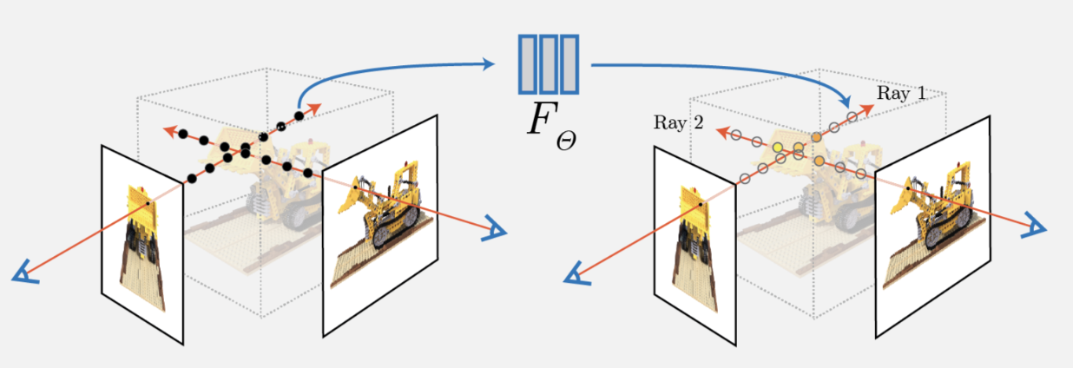
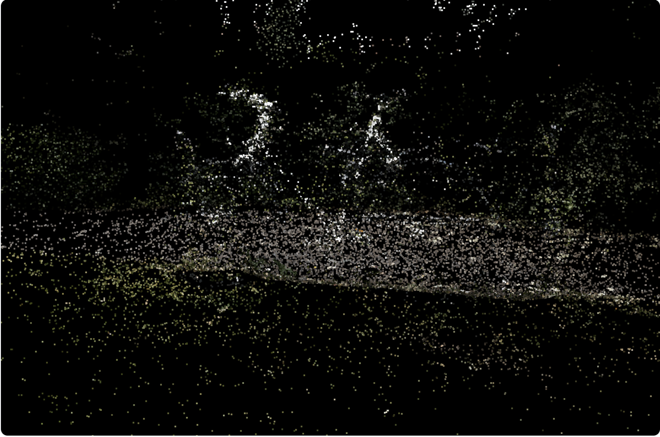
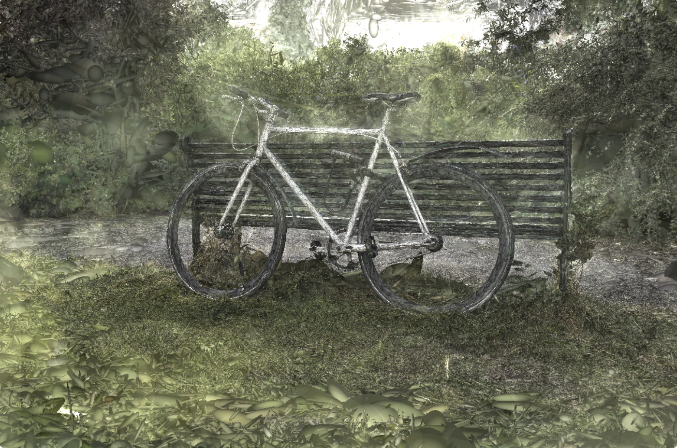
Background NeRF VS 3D Gaussian Splatting
Performance
Quality: depend on the density and distribution of the Gaussians.
Speed: Rendering can be faster than NeRF since it The optimization process can also be more efficient.
Generalization: Similar to NeRF, the representation can be scene-specific, but the optimization might be less computationally demanding.
Quality: NeRF produces highly detailed and photorealistic images
Speed: The process can be slow due to the numerous points and neural network multiple times per pixel.
Generalization: NeRF is scene-specific, meaning a separate model needs to be trained for each new scene.
Notes:
Quality: NeRF produces highly detailed and photorealistic images, capable of capturing fine details and complex lighting effects.
Speed: The rendering process can be slow due to the need to sample numerous points and evaluate the neural network multiple times per pixel. Training can also be computationally intensive and time-consuming.
Generalization: NeRF is scene-specific, meaning a separate model needs to be trained for each new scene.

Slide 8
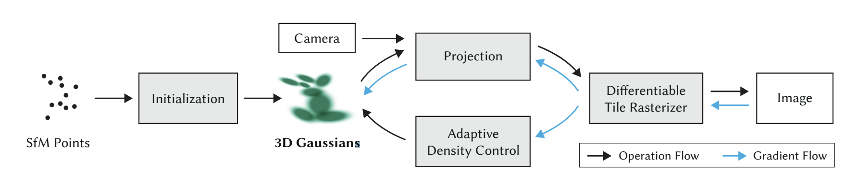
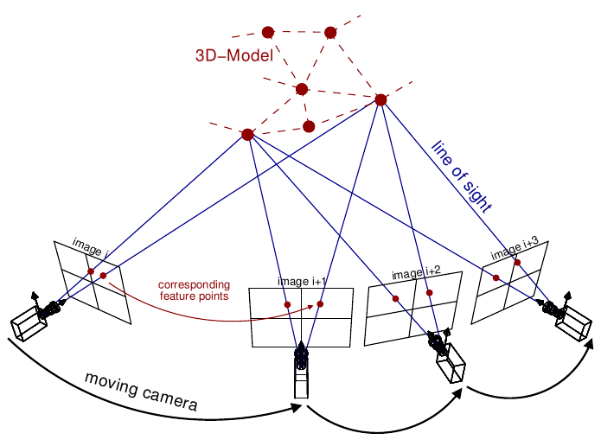
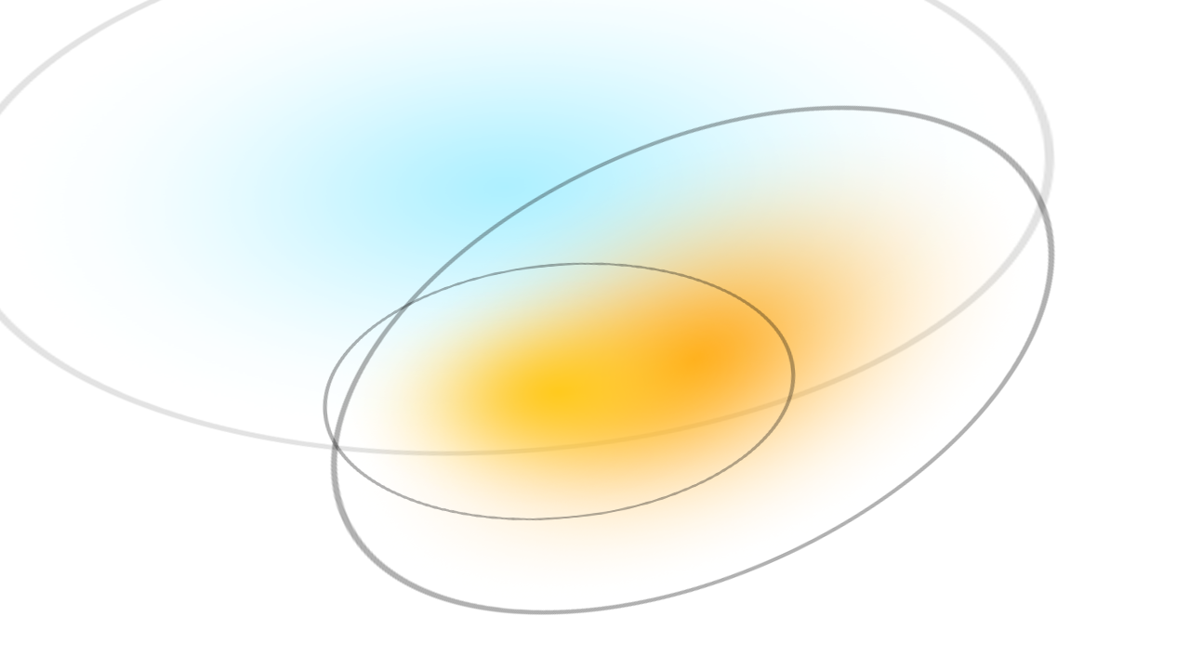
Methodology - 3D Gaussian Representation
Position: where it's located (XYZ)
Covariance: how it's stretched/scaled (3x3 matrix)
Color: what color it is (RGB)
Alpha: how transparent it is (α)

Slide 9
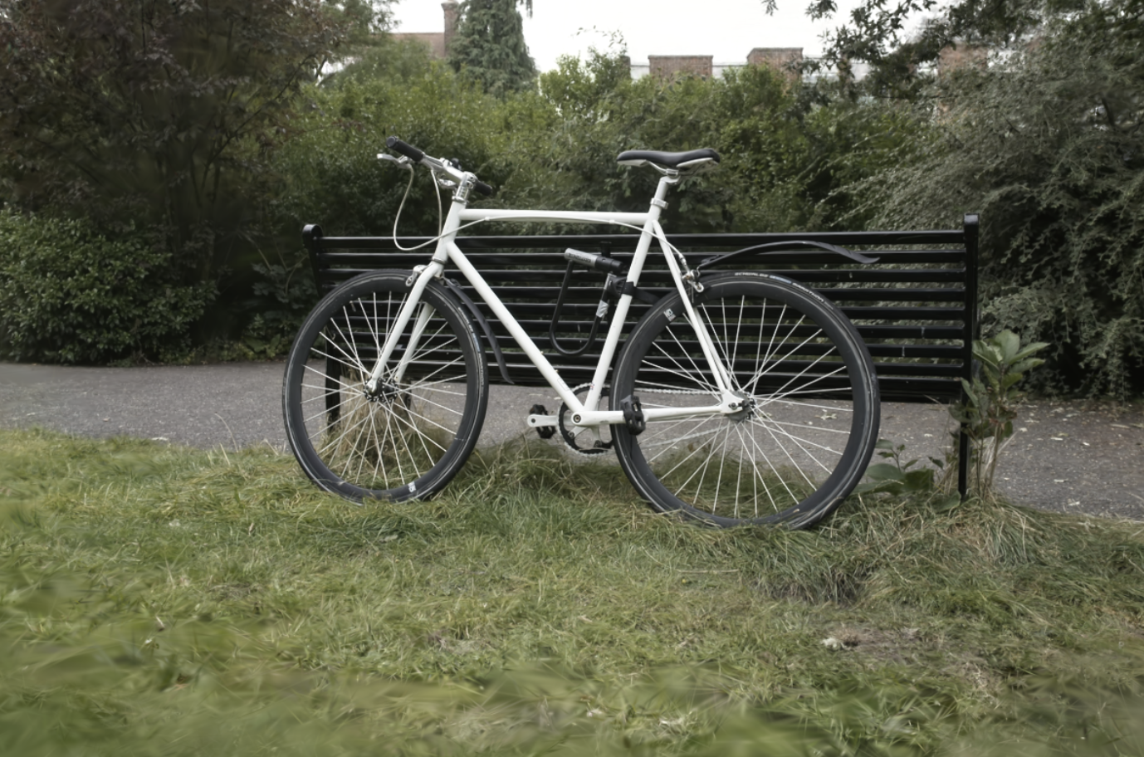
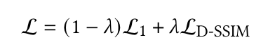
Methodology - Anisotropic Splatting
Compare Gaussians projection and ground truth image calculate the lost function

Slide 10
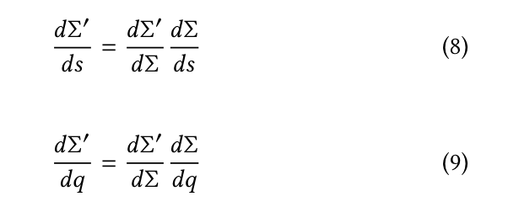
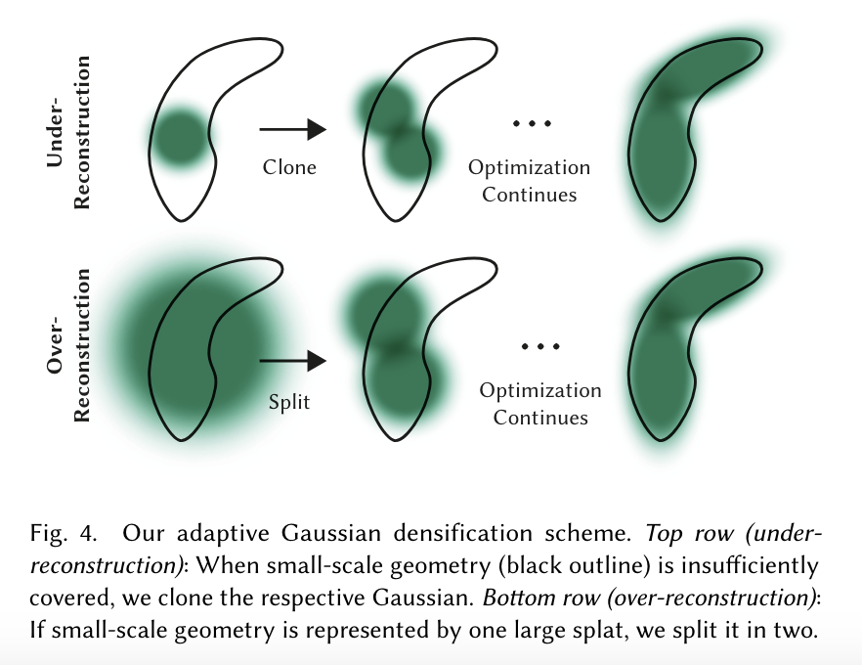
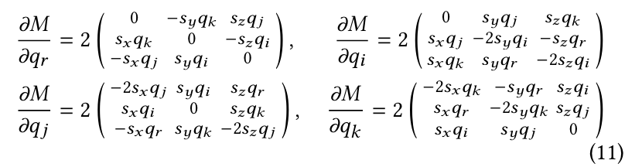
Methodology - Adaptive Control of Gaussians

Slide 11
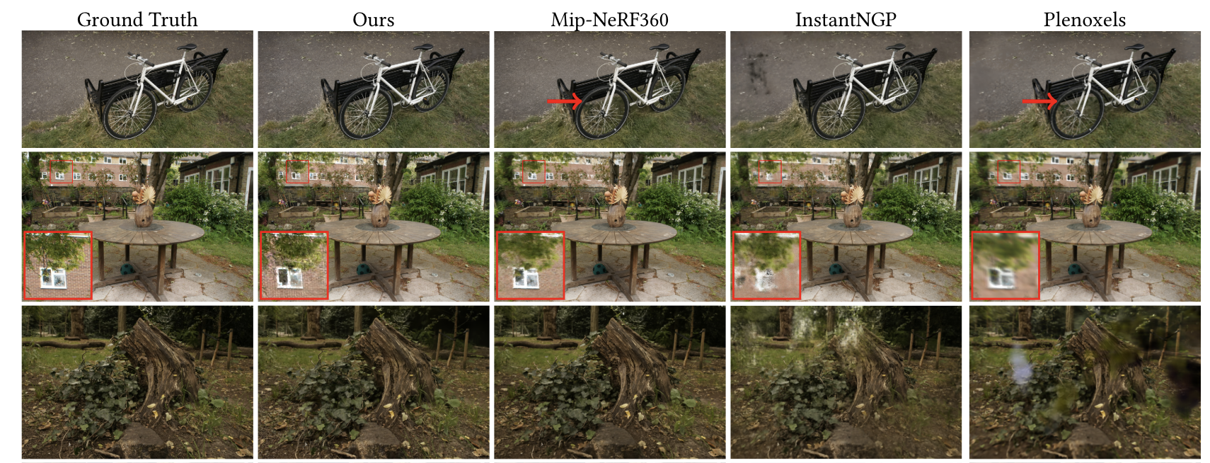
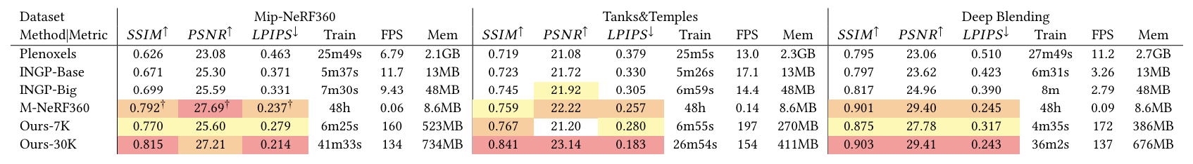
Evaluation and Results
Datasets: Real scenes from Mip-NeRF360, Tanks and Temples, Deep Blending.
Performance Metrics: Comparison with state-of-the-art methods.
Visual Comparisons: Demonstration of superior visual quality and real-time capabilitie

Slide 12
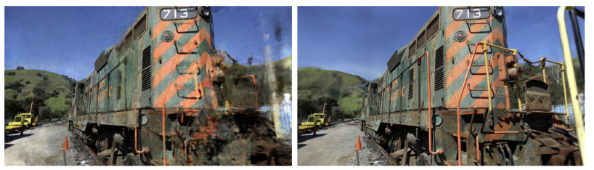
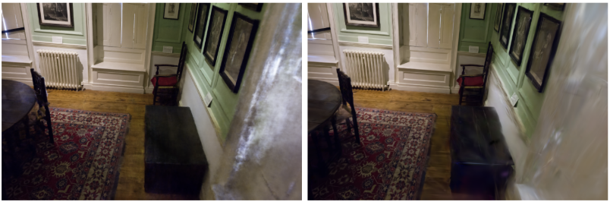
Limitations and Future Work
1. Artifacts in Poorly Observed Regions: The method produces artifacts in regions where the scene is not well observed, similar to issues seen with other methods like Mip-NeRF360.
2. Elongated and "Splotchy" Gaussians: Anisotropic Gaussians, while beneficial, can create elongated artifacts or "splotchy" appearances in certain areas.

Slide 13
Limitations and Future Work
3. Popping Artifacts: The optimization process can sometimes create large Gaussians that result in popping artifacts, particularly in regions with view-dependent appearance.
4. Memory Consumption: The method, while compact compared to previous point-based approaches, consumes significantly more memory than NeRF-based solutions.
Peak GPU memory usage during training can exceed 20 GB, especially in large scenes.
Future Directions:
Address popping artifacts.
Regularization: Applying regularization during optimization in unseen regions and popping issues.
Memory Optimization Further exploration of compression techniques and low-level optimization to reduce memory consumption.

Slide 14
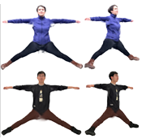
HUGS : Human Gaussian Splats
Photorealistic Rendering and Animation of Human Bodies
WHY: Crucial for AR/VR, visual effects, and movie production.
HOW : Early methods → Multi-camera setups and extensive manual effort. Recent advancements → 3D parametric models like SMPL (Skinned Multi-Person Linear Model)
Challenges :
Limitations in modeling clothing, hairstyles, and intricate details.
Inefficient in training and rendering

Slide 15
HUGS : Human Gaussian Splats
Overview
HUGS represent humans and scenes using 3D Gaussians.
utilizing 3D Gaussian Splatting (3DGS) with explicit control → improved training and rendering speeds
INITIALIZATION : SMPL model with deviations to capture finer details → Predicts the LBS (Linear Blend Skinning)
RESULT : Can render animatable human avatars at 60fps in HD resolution
Model the geometry and
appearance details (e.g., hair and clothing)
beyond the SMPL model
Allow the Gaussians to deviate, increase, and pruned from the SMPL model
Technique to deform the mesh based on the pose parameters

Slide 16
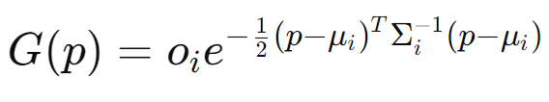
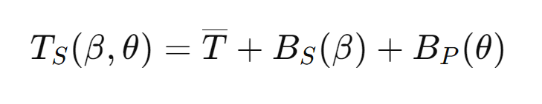
HUGS : Human Gaussian Splats
Methodology
INPUT : Monocular video containing camera motions, a moving human, and a static scene
Represent the human(SMPL) and scene(COLMAP) by arranging 3D Gaussians
p → Location
o(i) → Opacity
μ(i) → Center
Σ(i) → Covariance matrix
with Scale and Rotation
SMPL:
T → Template mesh
B(β) → Offset for shape deformation
B(θ) → Offset for pose deformation

Slide 17
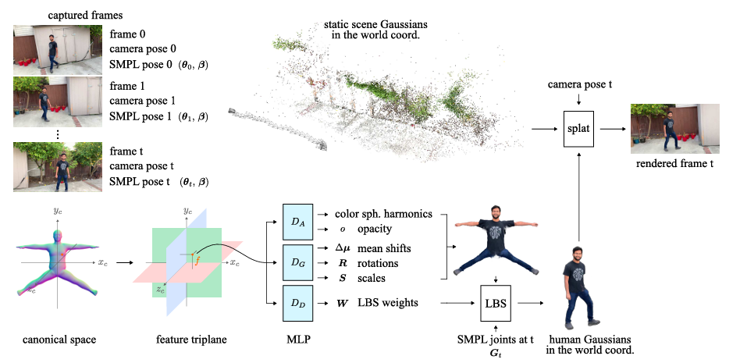
Each frame has a corresponding camera pose (θ, β)

Slide 18
Depicts the human body in a standard, rest pose (T-pose)

Slide 19
Each plane (x,y,z) holds features used to predict the properties of Gaussians.

Slide 20
(Multi-Layer Perceptrons)
Predicts color and spherical harmonics (o, opacity).

Slide 21
(Multi-Layer Perceptrons)
Predicts geometric properties: mean shifts (Δμ), rotations (R), and scales (S).

Slide 22
(Multi-Layer Perceptrons)
Predicts Linear Blend Skinning (LBS) weights (W) → Determine how each vertex of the mesh is influenced by the joints (which is determined by the θ

Slide 23
The human body is represented by Gaussians → Deformed using LBS based on the joints' positions from the SMPL model

Slide 24
Represents static elements in the scene using 3D Gaussians

Slide 25
Splatting Process:
Combines static scene Gaussians and human Gaussians.
Projects 3D Gaussians onto the image plane

Slide 26
(Multi-Layer Perceptrons)

Slide 27
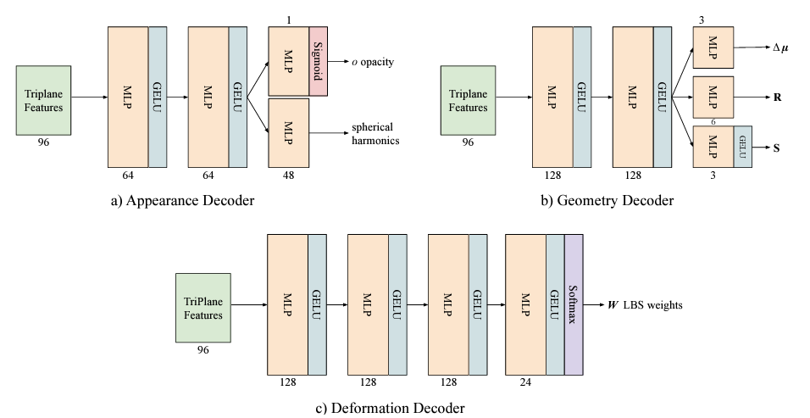

Slide 28
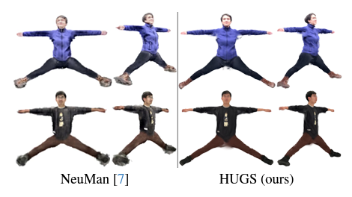
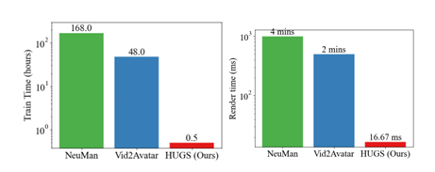
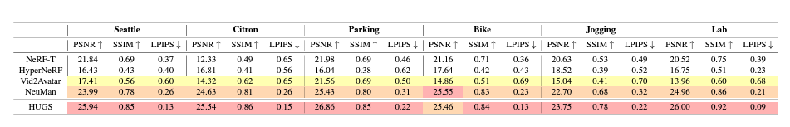
HUGS : Human Gaussian Splats
Results

